Slide 1
Proyecto: La canción
Carolina Hernández
Periodo: 2B
Español 2

Slide 2
Maná
mexican rock band

Slide 3
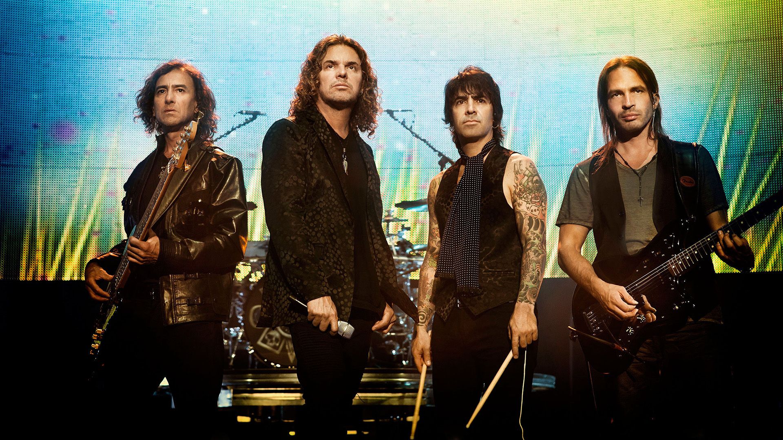

Slide 4
José Fernando Emilio Olvera Sierra
Nickname: Fher
Date of Birth:
December 8th
Place of Birth:
Puebla, Puebla; México
Main vocalist, songwriter, acoustic guitar, harmonica
Education: Bachelor of Arts in Communications
Family: Divorced, one daughter

Slide 5
Alejandro González Trujillo
Nickname: Alex “el animal”
Date of Birth:
February 24, 1969
Place of Birth:
Miami, Florida
Vocalist, songwriter, drummer, percussion
Family:
Columbian father,
Cuban mother, 2 brothers,
Adriana Amutio (girlfriend),
Rafaela (daughter)

Slide 6
Juan Diego Calleros Ramos
Date of Birth:
April 19, 1962
Place of Birth:
Guadalajara, México
Bass Player
Family:
Julián (father)
Alicia (mother)
11 siblings
Erika (wife) Paola (daughter)

Slide 7
Sergio Vallín
Nickname: “el maestro”
Date of Birth:
May 26, 1973
Place of Birth:
Aguascalientes, México
Guitarist (electric and acoustic)
Songwriter
Background Vocals
Family: Married, 3 Children

Slide 8
Canción: Te lloré un río
Autor/Compositor:
Fher Olvera
Lanzamiento del álbum:
el 27 de octubre de 1992
Argentina – 2 veces Disco Platino
#4 - U.S. Billboard Álbum Top Latino
#2 – U.S. Billboard Álbum Latino Pop
E.E.U.U. – 12 veces Disco Platino

Slide 9
ÁLBUM: ¿Dónde jugarán los niños?

Slide 10
Galería de fotos

Slide 11
Galería de fotos

Slide 12
Galería de fotos

Slide 13
VIDEO OFICIAL:

